Slide 1
MA-PIP
Coach/Practice Manager Session
June 10, 2016
McGuire Conference Room
8:00 am – 10:00 am
Learn, Do, Teach

Slide 2
Sustaining Change
- Lora Gross-Kostka
- Judy Ling
Judy
Start Time: 9:35am
Teach Time: 10 min

Slide 3
Strategies to Sustain
Lora –
  Practices can:
    Start Staff Meetings with asking if there are Patient Safety Concerns
    Share PI run charts in staff break rooms
    Share patient stories with each other
    Consult “parking lot” or “glitch book” for PI ideas
Judy –
  Hierarchy of Sustaining Change

Slide 4
Strategies to Sustain Change
Consideration: Changes in leadership
Ex. In recruiting for new office practice managers, Directors can look for candidates with PI training, i.e. experience with MFI
Consideration: Monitoring for change
Ex. Once enough data points are available; team leaders can post run-charts in staff room

Slide 5
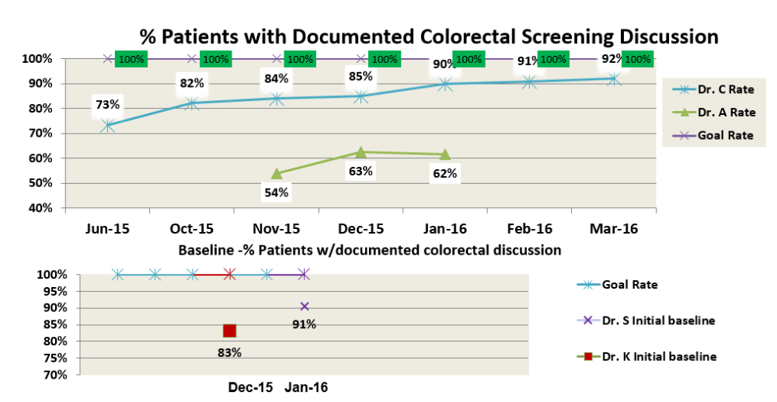
Sample Run Chart

Slide 6
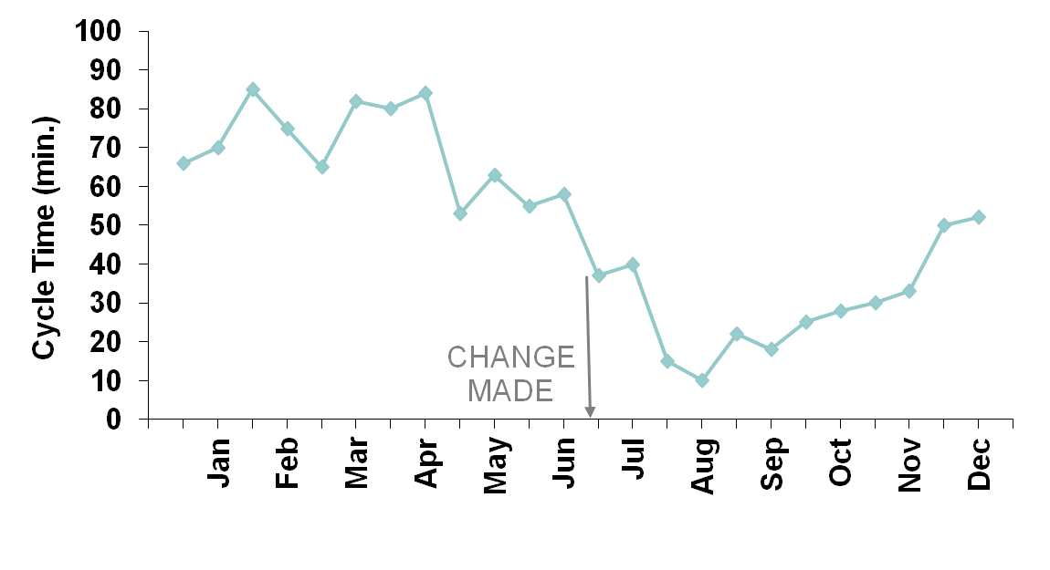
Your Improvements - Are They Sustainable?
SUSTAINABLE?
Notes:
6

Slide 7
Hierarchy of Sustaining Change
Weakest
Policies,
training,
inspection
ASK: does the change depend on well meaning person or well designed system?
Minimize
consequences of errors
Make errors visible
Make it easy to do the right thing
Make it hard to do the wrong thing
Eliminate opportunity for error
Strongest
Standardization & Simplification
Doug Bonacum, Kaiser Permanente

Slide 8
PDSA
- Susan McDonnell
- Judy Ling
Start Time: 9:20 am
Teach Time: 10 min

Slide 9
PDSA Topics
Susan
Testing SMALL! Fail Fast, Fail Often!
Using the PDSA Form
Importance of predicting an outcome
Adopt/Adapt/Abandon
  Does this work? Shall we tweak and re-test?
  Does this work when main person is out?
  Does this work on weekends?
  What is the back-up plan
Judy
What is a hypothesis?
Difference between Test and Task.

Slide 10

Using the MFI Framework
Answer what are we improving, how much, by when.
To increase/decrease XXX by ZZ% by YY date.
Sample measurement
Number of XXX (numerator)
Total number of XXX (denominator)
Team to provide test ideas.
PDSA =
The PDSA form can be used when you get here
Developed by: Associates in Process Improvement
Notes:
Need to know baseline before you can increase or decrease by xx%

Slide 11
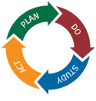
Small test of change
One day
One provider
One question

Slide 12
Use the PDSA Form
Plan – Questions and Predictions
Plan - who, what, where, when
Do – Carry out the plan
Do – Document data, results and unexpected observations
Act – What changes are being made
Study – Complete, Compare and Summarize

Slide 13
Predicting an outcome
Predicting your outcome is important to do as a group
Ask
Discuss
Brainstorm
Listen – a great TED Talk!
  https://www.ted.com/talks/ernesto_sirolli_want_to_help_someone_shut_up_and_listen
Evaluate

Slide 14
Adopt/Adapt/Abandon
What did we accomplish
What changes have we made
Does this change result in an improvement

Slide 15
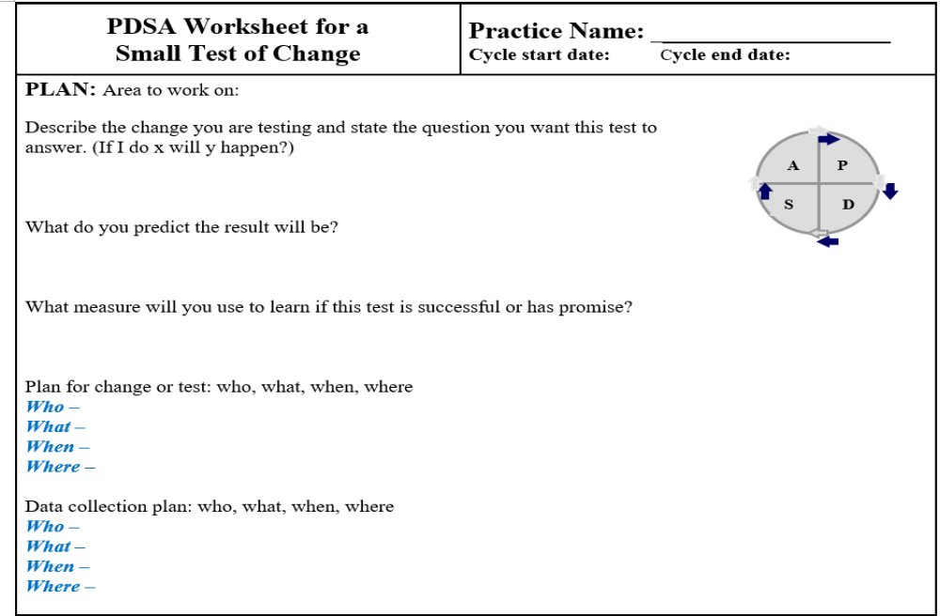
Blank PDSA Form

Slide 16
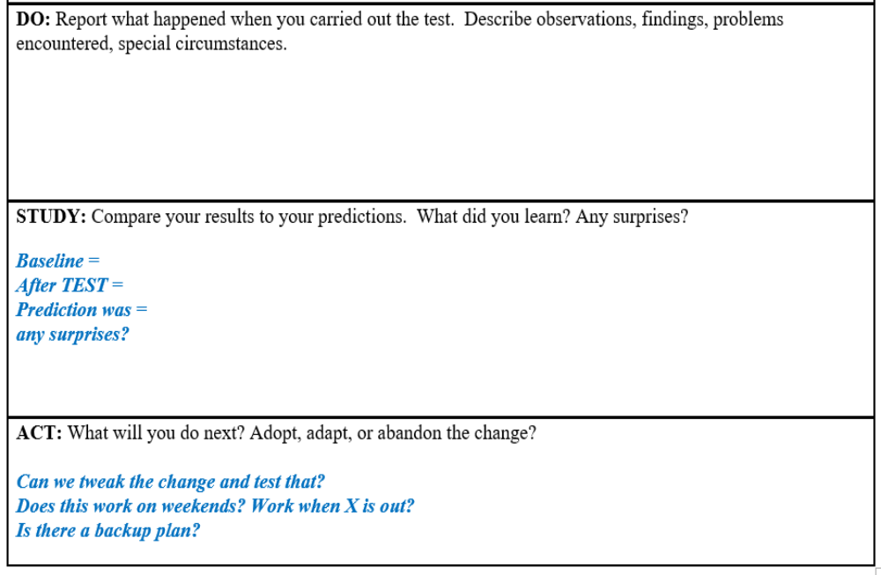
Blank PDSA Form

Slide 17
Test Ideas
A good test idea answers a hypothesis.
  Hypothesis – if we send a patient letter explaining why a diabetic eye exam is so important, an educated patient would be more likely to complete the eye exam.
    Test – Send letter to diabetic patient population with clearly stated reasons why eye exams are necessary, and give names/locations/times of eye exam providers.
      Task – Write draft letter.
      Task – show draft letter to select patients to get feed-back.
Allows you to answer y/n to hypothesis
Makes the test possible

